Slide 1
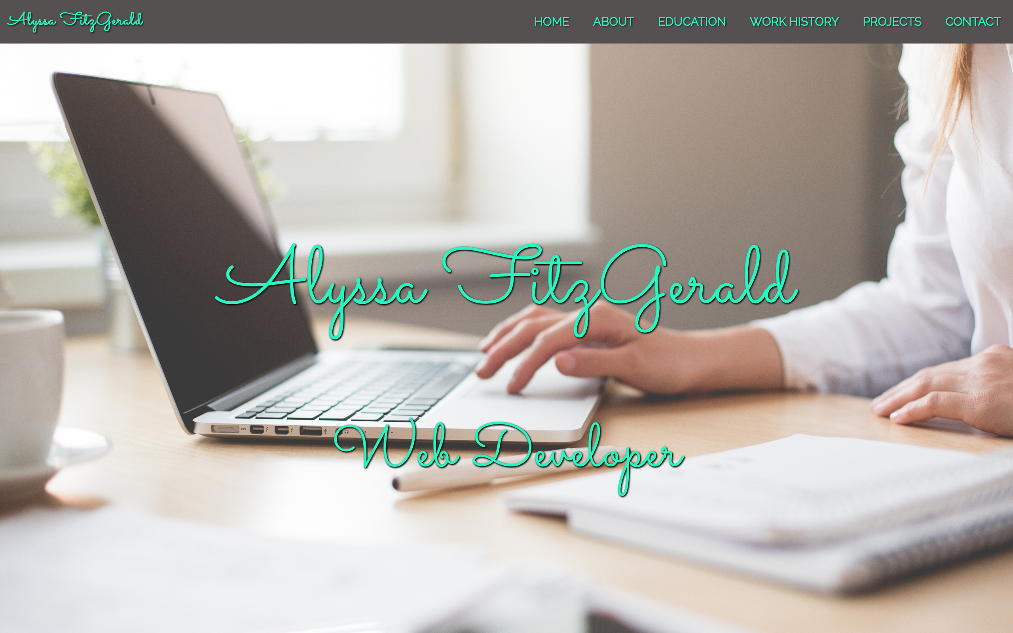

Slide 2
Walkthrough of live portfolio website
Single-page website
https://lyssfitz.github.io/

Slide 3
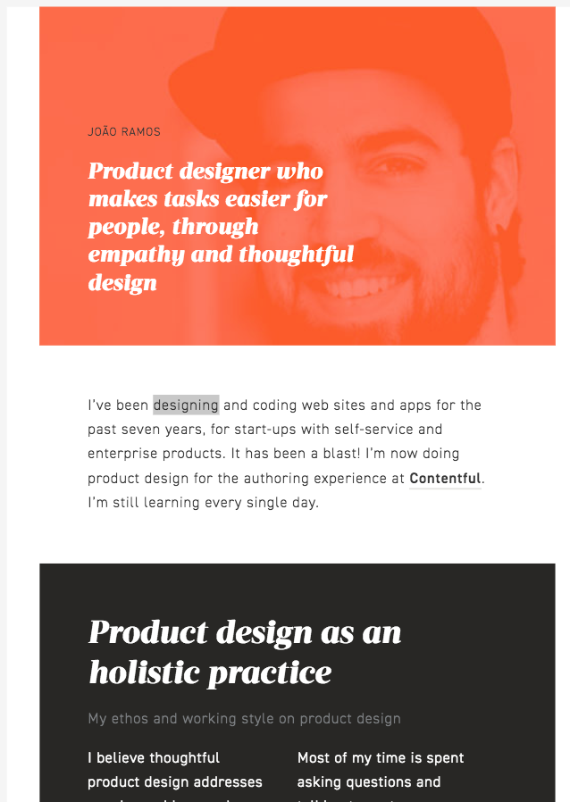
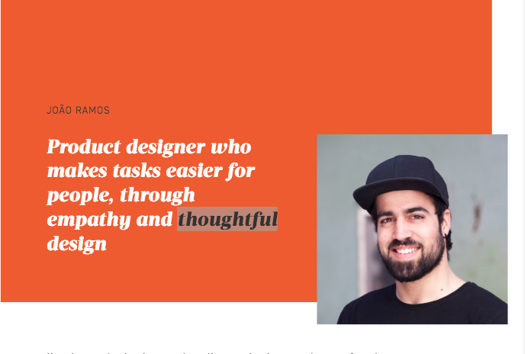
Design process and decisions
Inspiration: A few portfolio websites – particularly liked moving boxes style for responsive design

Slide 4
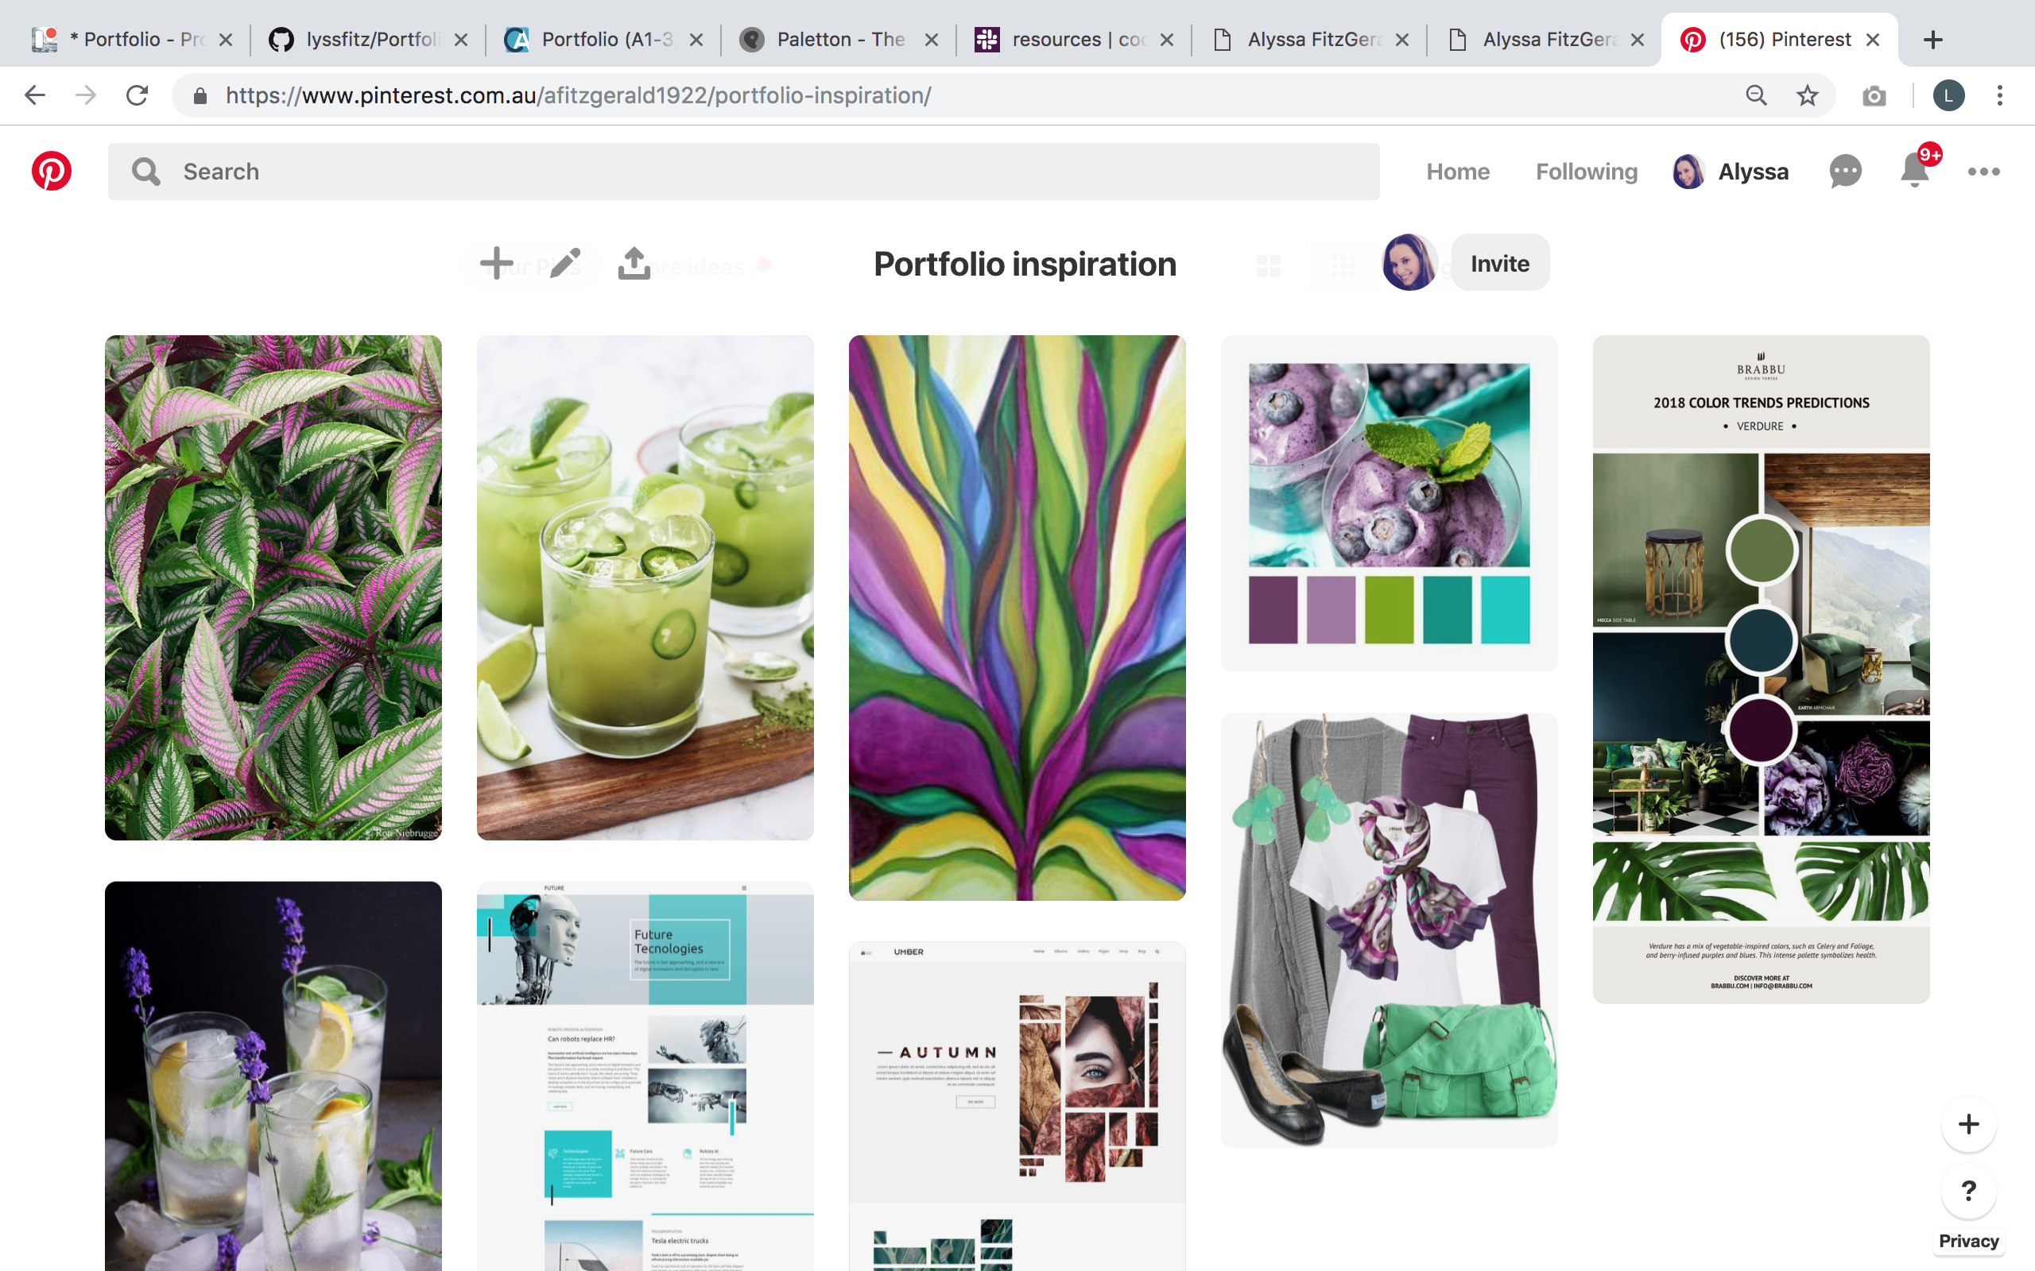
Moodboard
Initially started with a broader colour palette…

Slide 5
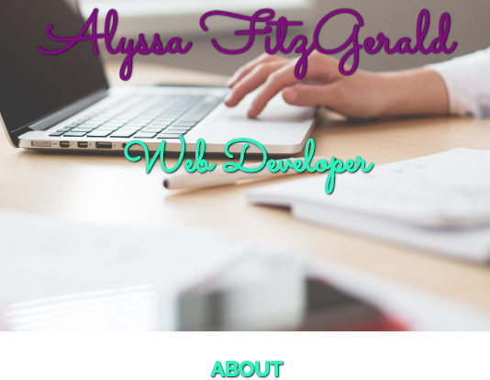
Moodboard (cont)
But it made my site look a little too busy:

Slide 6
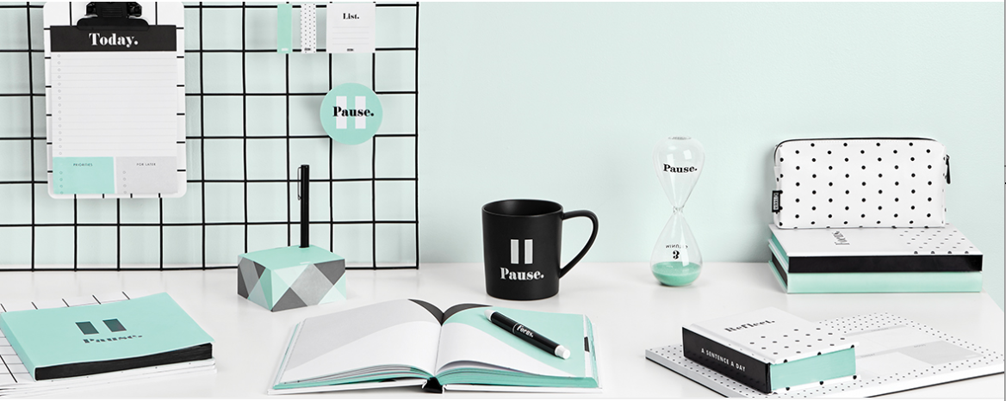
More inspiration… Kikki K!

Slide 7
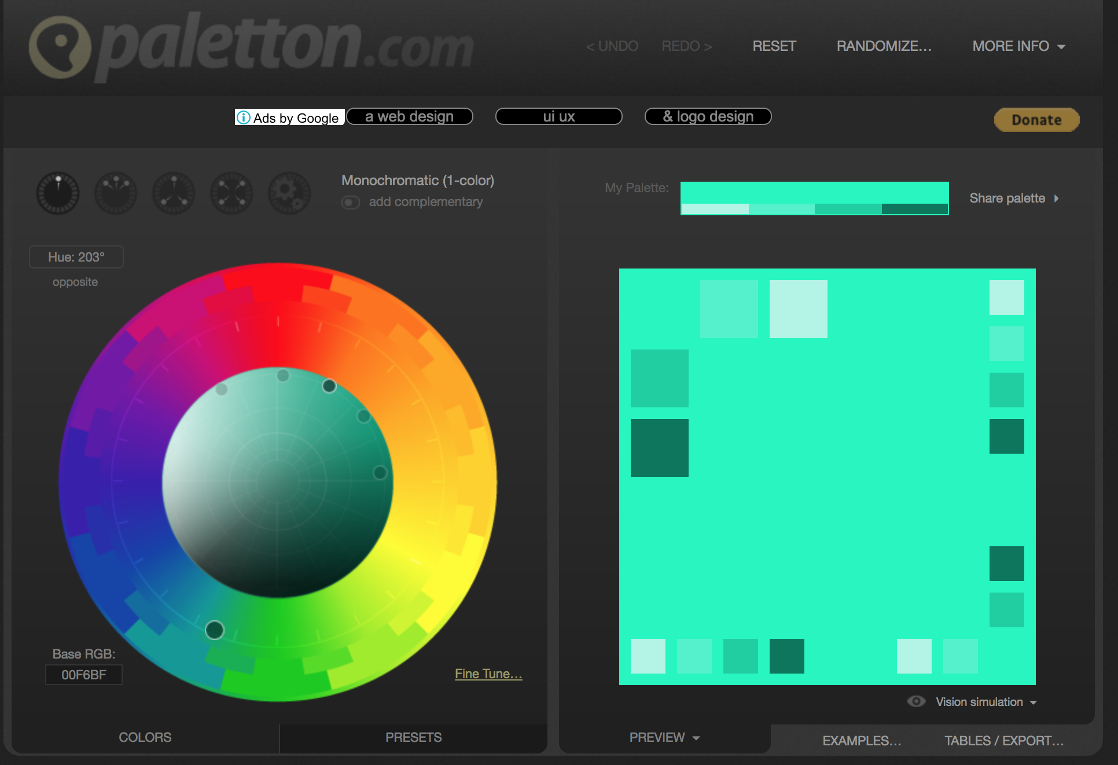
Color palette

Slide 8
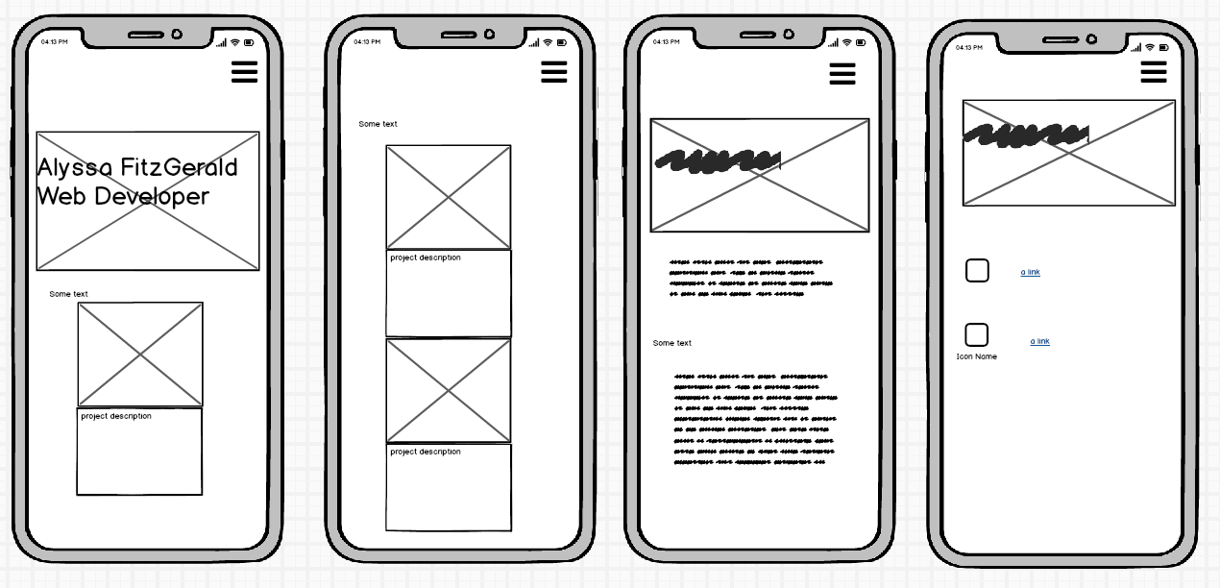
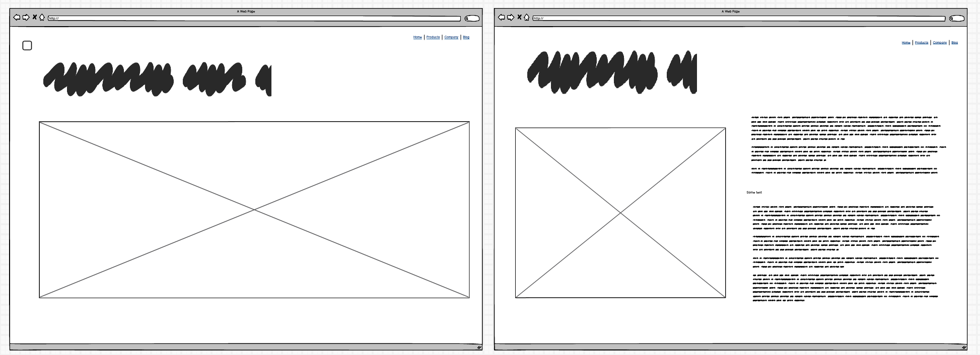
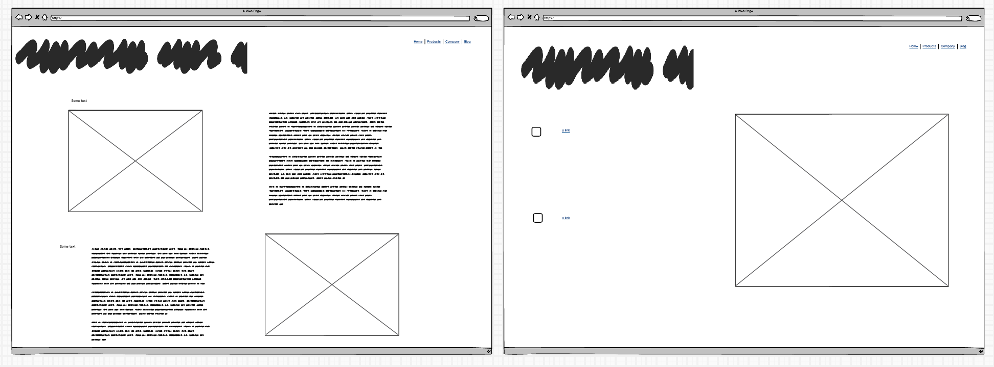
Started with these wireframes…

Slide 9
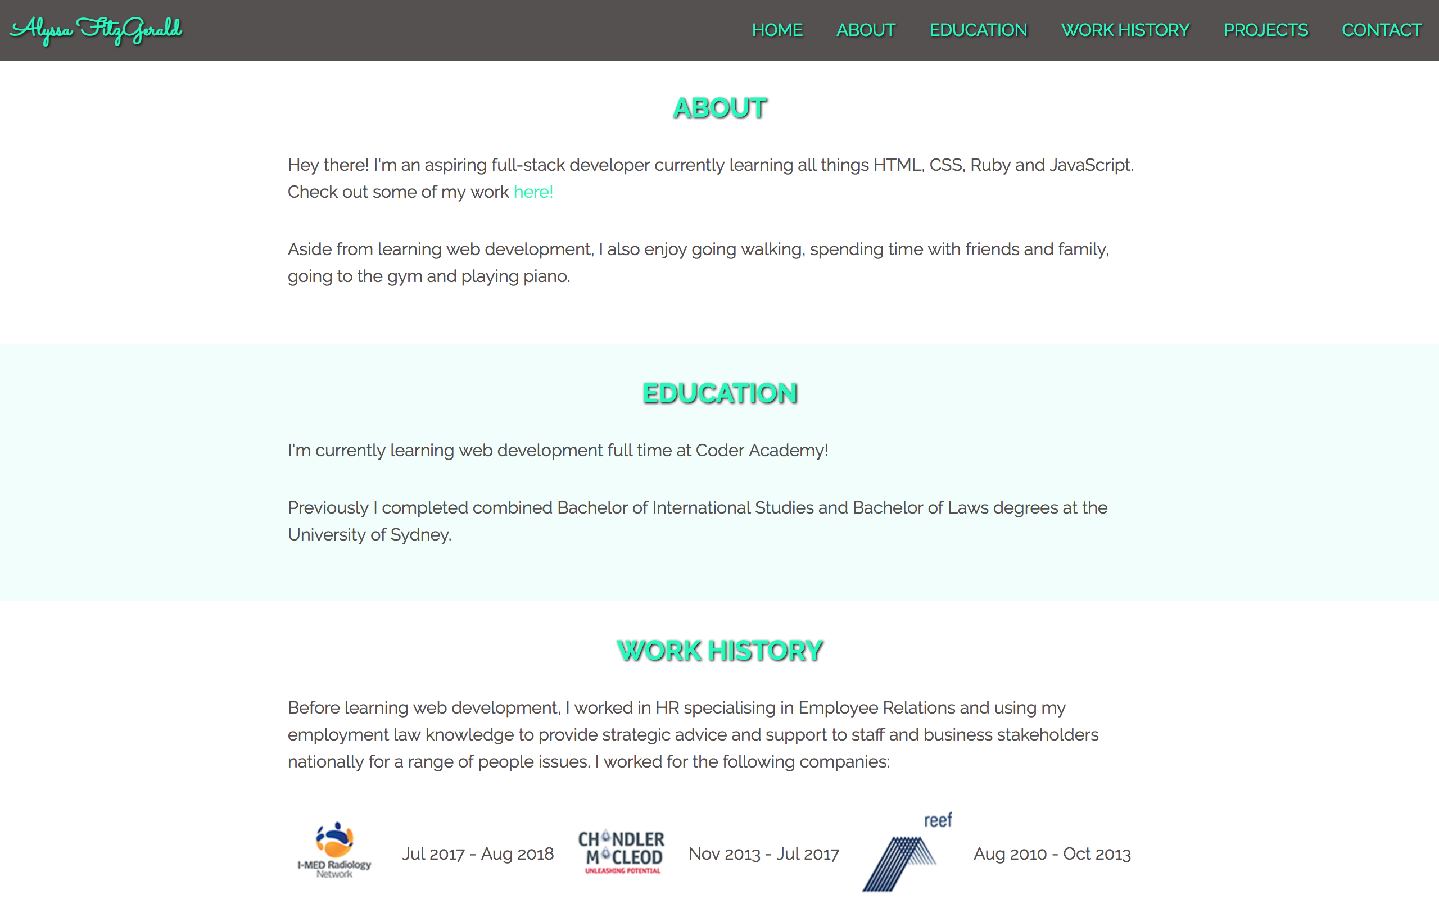
But it didn’t quite fit some content right…
So I changed some of it!

Slide 10
Challenges
Getting my head around Flexbox (initially!)
Making the layout work for 3 breakpoints
Deciding how much info to include and what to leave out.

Slide 11
Favourite Parts
Getting the text overlaid on the hero image properly
Getting the nav bar to be functional
Making the website responsive.

Slide 12
Ethical Issues…
Accessibility?

Slide 13
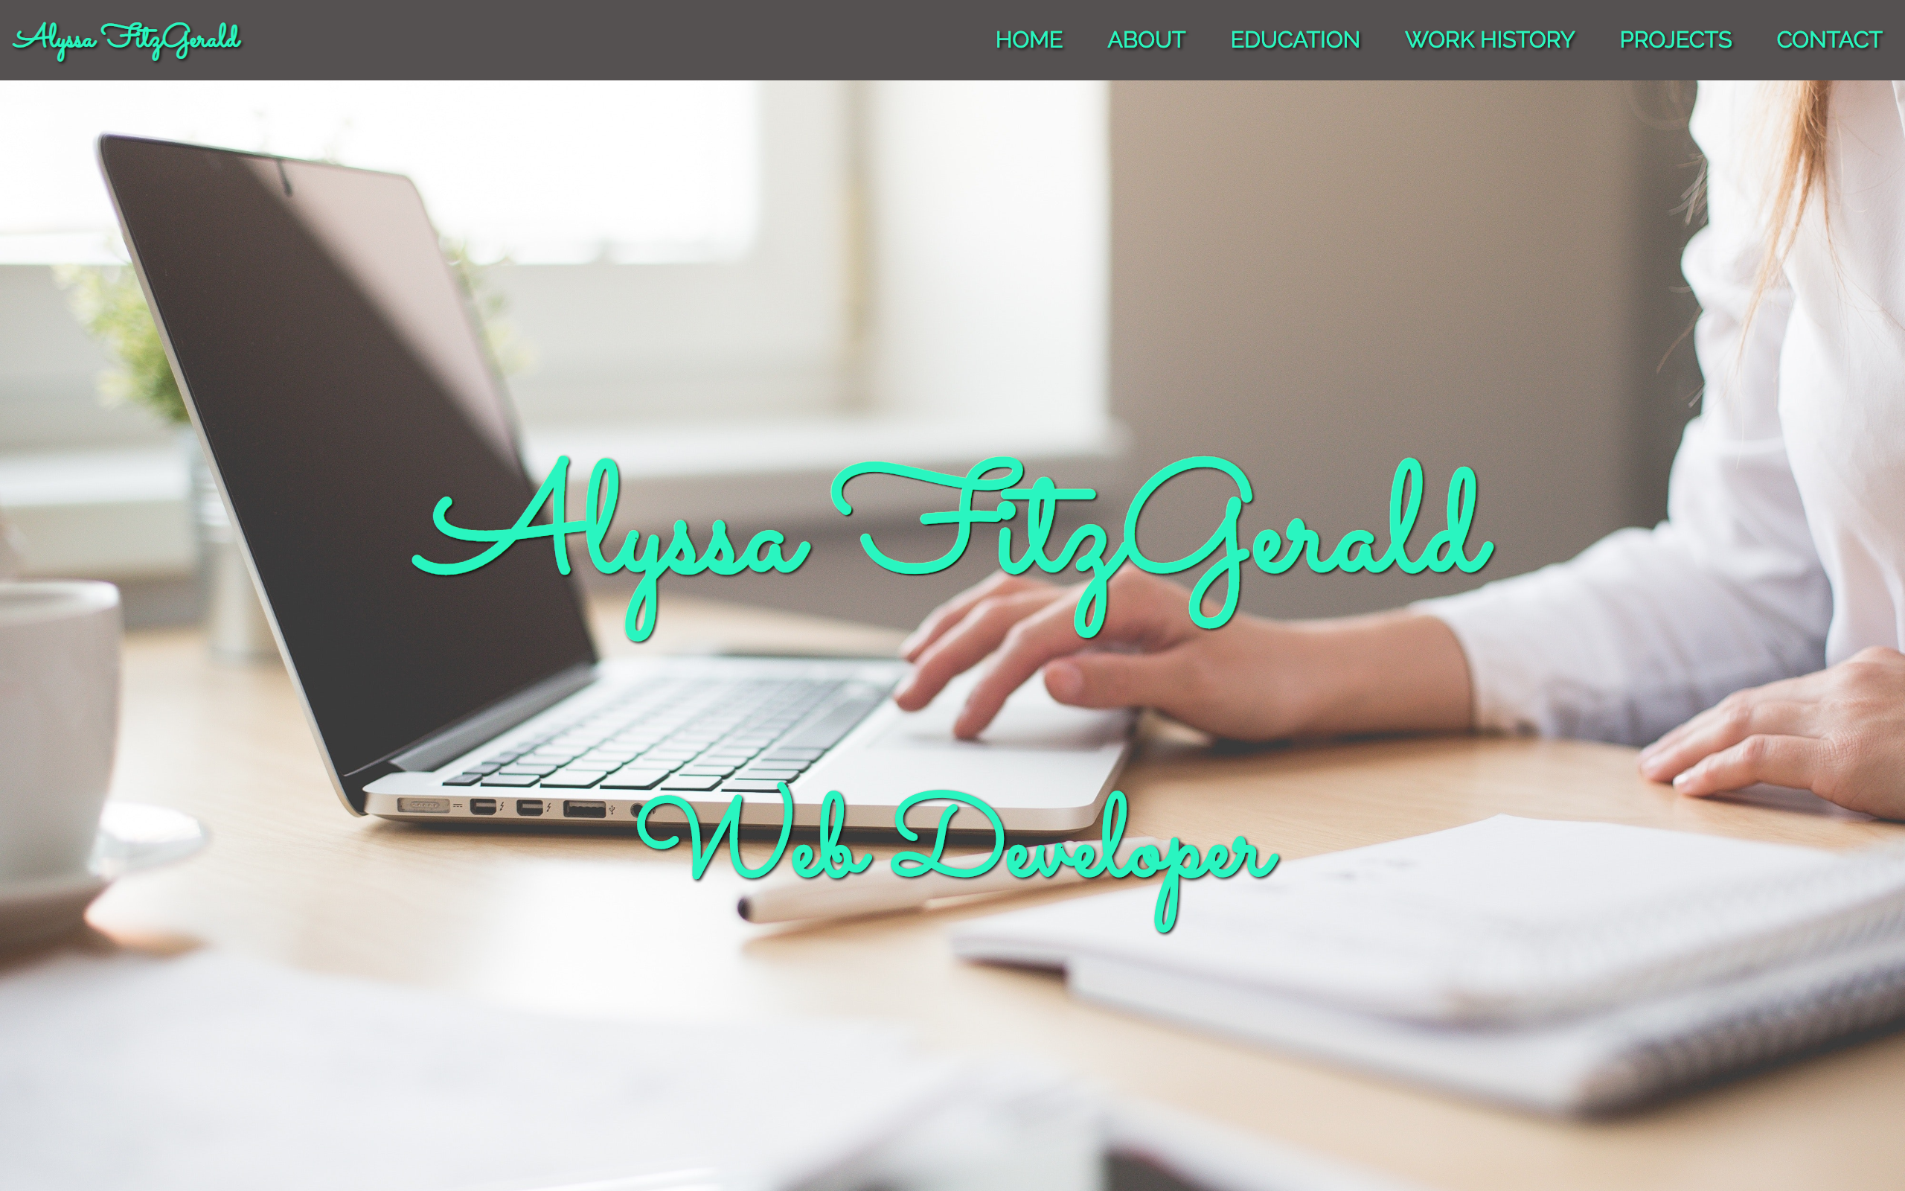
Questions?

